Slide 1
Website Assignment
ASP.NET MVC

Slide 2
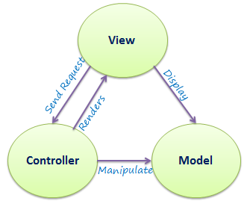
MVC Project
MVC stands for Model, View and Controller. MVC separates application into three components - Model, View and Controller. Model: Model represents shape of the data and business logic. It maintains the data of the application. Model objects retrieve and store model state in a database.

Slide 3
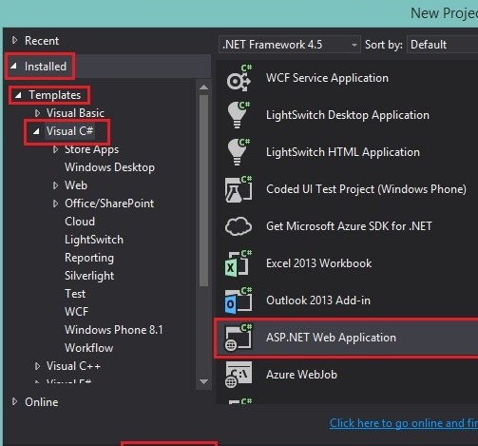
Creating Project from Scratch
Next on the next window, select Empty on the template window and click on
the MVC checkbox below on the Add folders and core references for: then click OK.

Slide 4
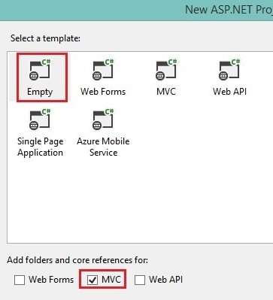
Select A Template
After creating with MVC selection we would get these folders in our project.
App_Data
App_Start
Controllers
Models
Views

Slide 5
Creating the Authentication Middleware using Identity
Next, we’ll create our middleware using ASP.NET’s identity. You might ask what a middleware is. In a nutshell, a middleware is the pipeline between the communication of the server and the application. For short, its a bridge between the two. You can read more on this great article. On the Solution Explorer located on the right, right-click on App_Start. Go to Add > Class…

Slide 6
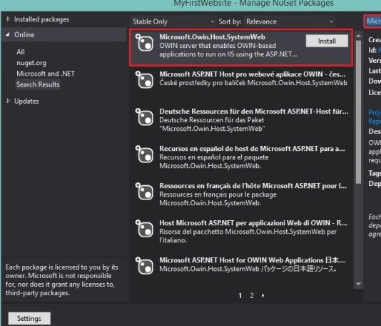
Installing the Owin Packages
From the Solution Explorer, right-click on
MyFirstWebsite then click on Manage NuGet Packages…
On the search bar on the upper-right, type in Microsoft.Owin.Host.SystemWeb then click on Install beside it then just agree on the terms and continue. Wait for the installation to finish. We are installing Owin, .NET’s middleware specifiation.
After, your should see a green check-mark beside it indicating that its successfully installed. This time, type on the search Microsoft.Owin.Security.Cookies
This is the libraries we downloaded earlier and now we’re placing it as a reference.
using Microsoft.Owin;
using Microsoft.Owin.Security.Cookies;
using Owin;

Slide 7
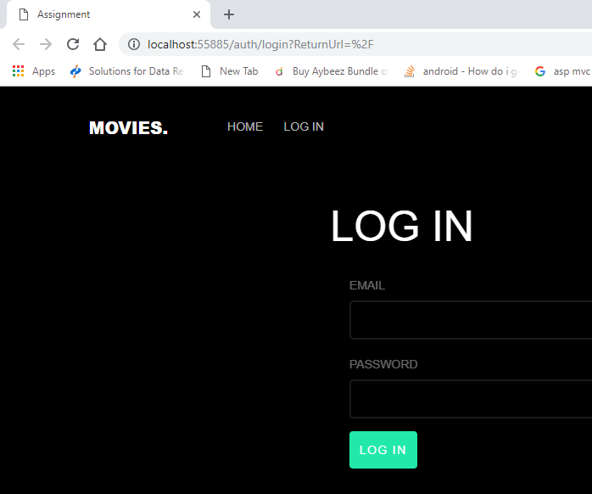
Login Model
Run the app and type in the email address “admin@abc.com” and password “A1234a” then click on submit. It should look like this, displaying your input.
User Name must be combination of letters and numbers only.
Password length must be 6 to 18 letters, contains atleast one digit, atleast one upper case and atleast one lower case and no whitespace.

Slide 8
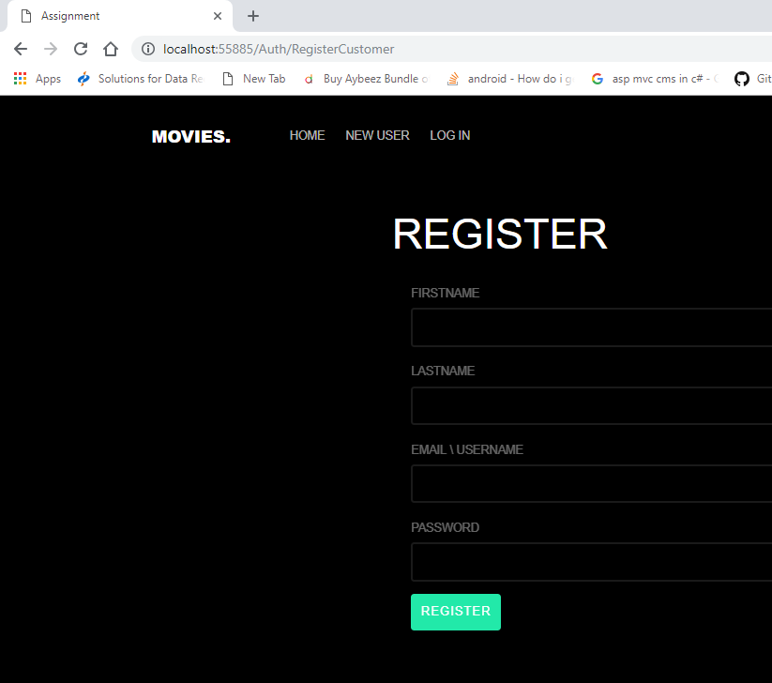
Registration
There are two types of Registration , one for is user and other is Admin.
Administrators are registers by other administrators and navigate the administrator view if the site.
To register with the system, a user must fill in a list of required fields before submitting the form. If the transaction is successful the user account will be created within the system.
FIRSTNAME
LASTNAME
EMAIL \ USERNAME
PASSWORD
User must register to be allowed to navigate the site and post any desired transaction.

Slide 9
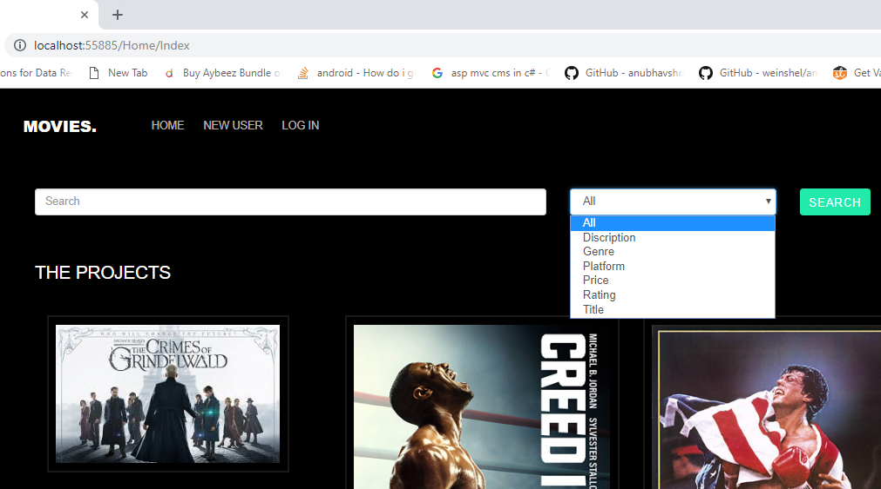
Home Page
The home page feature dropdown menus as a means to
search for a movie.
The dropdown menus are labeled: Title, Description,
Platform, Rating, Genre, Review and Price.
The data used for the dropdown menu is retrieved from
the Catalog component.
The number can select items from the dropdown menus.
The member can use all the menus or some of the menus.

Slide 10
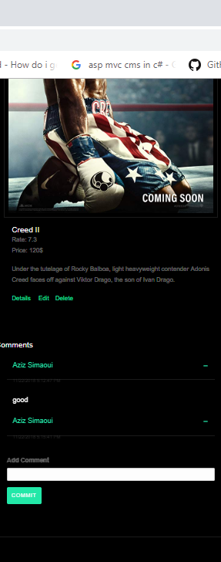
Detail Page
This page shows full detail about Rating of movies, user comments and
user can write own comment with the help of comment bar which name
is Add Comment.
The movie detail also shows on this page which is very helpful for user
who can see about movie description.
Only Admin can use three options for a uploaded movie the one is Delete
Second is Edit and third one is Details.
Date and Time also show on comment which is created by user.

